Slide 1
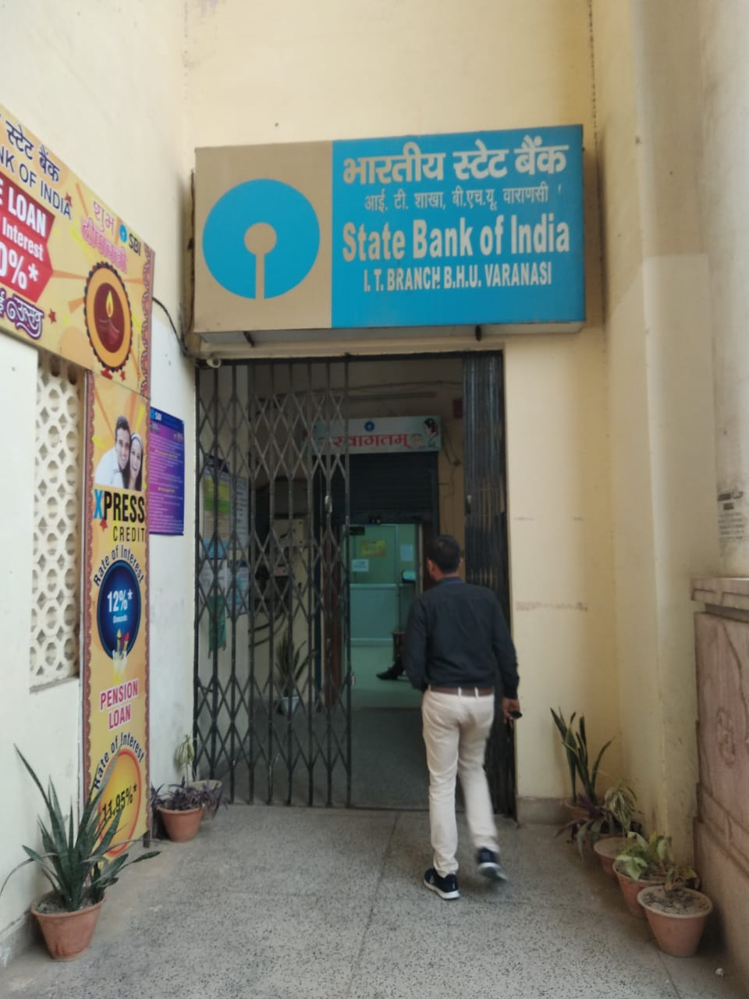
SIMULATION OF
SBI I.T. BRANCH B.H.U.
VARANASI
SUBMITTED BY
PRASHANT SINGH
SANDEEP KUMAR KUSHWAHA
SUBMITTED TO
PROF. A.K.AGRAWAL

Slide 2
ABOUT THE SYSTEM
Bank opens from 10:00A.M – 04:00P.M.
Peak hours are from 10:00A.M- 12:00 P.M.
It has 3 counters, one cash counter and other two are for non cash transaction purpose.
We are simulating the cash counter.

Slide 3
OBJECTIVE
TO REDUCE THE AVERAGE WAITING TIME OF THE CUSTOMERS IN THE CASH COUNTER LESS THAN 5 MINUTES.

Slide 4
SYSTEM DESCRIPTION
ENTITY ATTRIBUTES
CUSTOMERS amount of cash withdraw/deposit ,arrival rate
EMPLOYEE service rate
Waiting time is the time difference between a customer joins the queue and he gives his slip to the employee .
Service time is the time difference between when a employee receives the slip and customer leaves the window.
The arrival of a customer will be considered when he joins the cash counter queue after filling the slip.

Slide 5
ACTIVITIES
Making a deposit.
Making a withdrawal.
EVENTS
Customers joining the queue.
Customer leaving the window

Slide 6
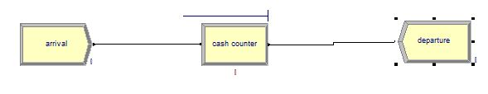
ARENA MODEL

Slide 7
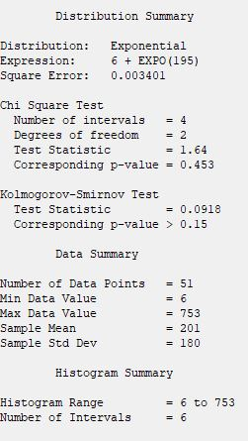
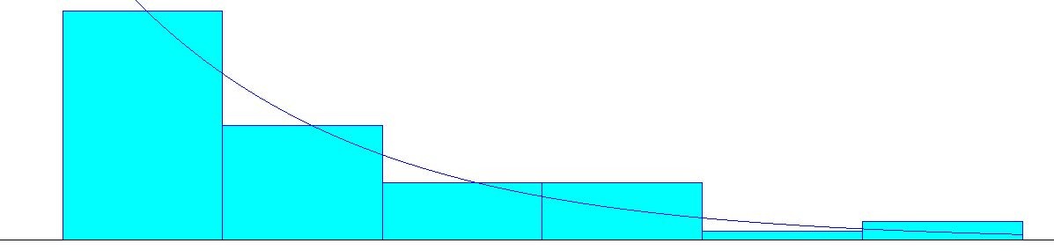
INTER-ARRIVAL TIME PATTERN

Slide 8
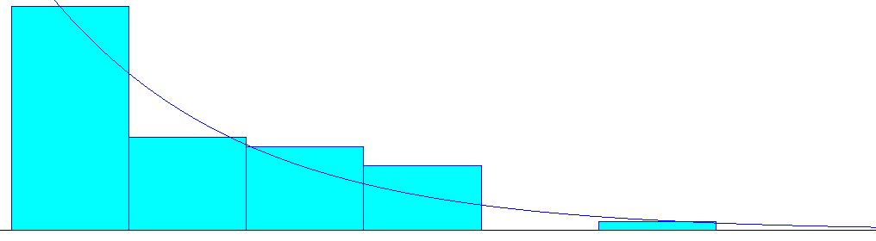
SERVICE PATTERN

Slide 9
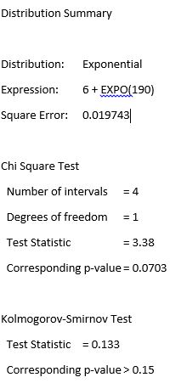
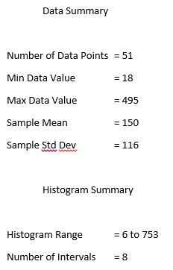

Slide 10
The waiting time of successive customers was measured and the average waiting time was found to be 10.12 minutes.
For the purpose of validation , we will consider this to be the true mean value X= 10.12 minutes.
VALIDATION TEST
We will compare our calculated average waiting time X=10.12 minutes to the model response Y.

Slide 11
STATISTICAL TEST OF NULL HYPOTHESIS
H0 :E(Y)=10.12minutes
versus
H1:E(Y) ≠ 10.12 minutes
We have choosen level of significance α = 0.05 and sample size n=6

Slide 12
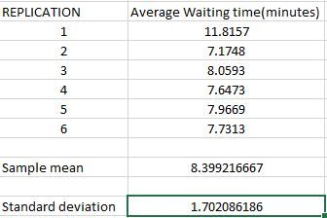
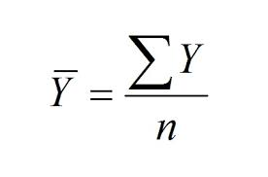
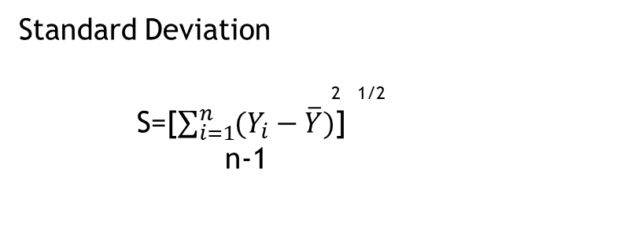
Results of six replication of the Bank Model
Sample Mean
Standard Deviation
2 1/2
S=[$\sum_{i=1}^{n}{(Y_{i}−\overline{Y})}$]
n-1

Slide 13
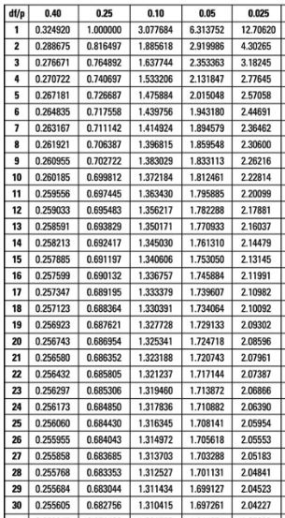

Test Statistics :
$t=\overline{(Y}$-X)/(S/√N)
t = (8.399-10.12)/(1.702/√6)
t = -2.4768
|t|= 2.4768
From the table ,
t0.025,5 = 2.571
Since,
t0.025,5 > |t|
Hence , Null Hypothesis
cannot rejected.
It is weak conclusion.

Slide 14
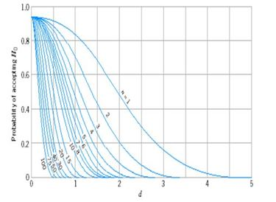
Now we proceed to Beta testing.
Where ß = P(Type II error) = probability of accepting the model as valid when it is not valid .
We would like to reject H0 with probability at least 0.90 if the true average waiting time of the model E(Y) , differ from the average waiting time in the system (X) by 1 minute.
𝛿 = |E(Y)-X|/ s
= 1/1.702
=0.587
For two sided test with α=0.05
We get ß(0.587)=0.80 for n = 6
To get ß(𝛿)≤0.1, from graph we get n=35
Replications would be required

Slide 15

RESULTS OF 35 REPLICATIONS
replications | average waiting time
1 | 11.8157
2 | 7.1748
3 | 8.0593
4 | 7.6473
5 | 7.9669
6 | 7.7313
7 | 7.3865
8 | 10.2011
9 | 11.4599
10 | 11.9588
11 | 12.2371
12 | 12.2371
13 | 11.4781
14 | 11.8645
15 | 11.2777
16 | 11.1598
17 | 11.1322
18 | 11.771
19 | 11.5888
20 | 11.0633
21 | 10.6705
22 | 11.1439
23 | 10.9026
24 | 10.6239
25 | 10.4378
26 | 10.5802
27 | 10.2836
28 | 10.1617
29 | 10.1054
30 | 9.9136
31 | 9.7035
32 | 9.4675
33 | 9.5539
34 | 9.7187
35 | 9.9398

Slide 16

H0 :E(Y)=10.12minutes
versus
H1:E(Y) ≠ 10.12 minutes
level of significance α = 0.05 and sample size n=35
$t=\overline{(Y}$-X)÷(S/√N)
T=0.7293
Since,
t0.025,34 > |t|
Hence , Null Hypothesis cannot rejected.
It is weak conclusion
STATISTICAL TEST OF NULL HYPOTHESIS

Slide 17
Now proceed to ß testing
𝛿 = |E(Y)-X|/ s
= 1/1.441
=0.694
From OC Curve of two sided test with α=0.05
We get ß(0.694)< 0.1 for n = 35
Hence there are less than 10% chances that an invalid model is accepted.
To determine whether to accept the model as valid or to refine the model depends on the best-case and worst-case error implied by the confidence interval.

Slide 18
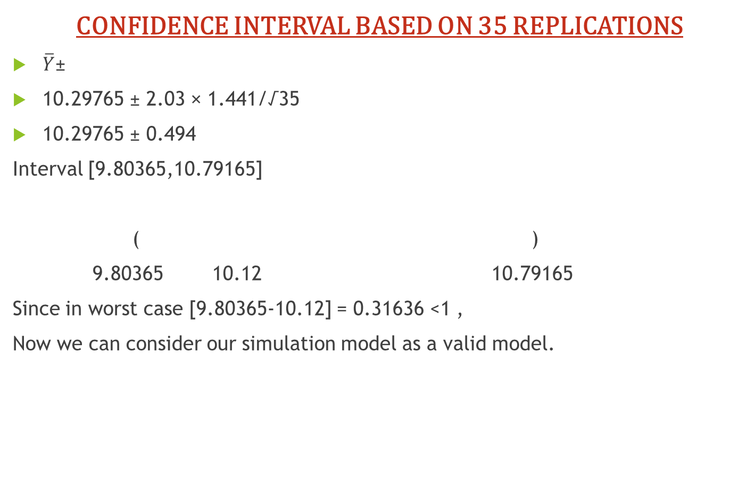
CONFIDENCE INTERVAL BASED ON 35 REPLICATIONS
$\overline{Y}$±
10.29765 ± 2.03 × 1.441/√35
10.29765 ± 0.494
Interval [9.80365,10.79165]
( )
9.80365 10.12 10.79165
Since in worst case [9.80365-10.12] = 0.31636 <1 ,
Now we can consider our simulation model as a valid model.
t0.025,35-1×S/√n
Worst case
Best case

Slide 19
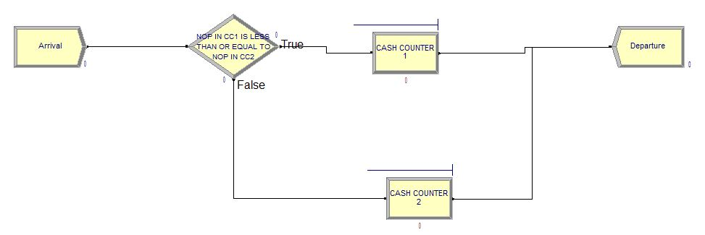
Now, for reduce the average waiting time of the customers <= 5 minutes, we can add one more cash counter in our system.
ARENA MODEL:

Slide 20
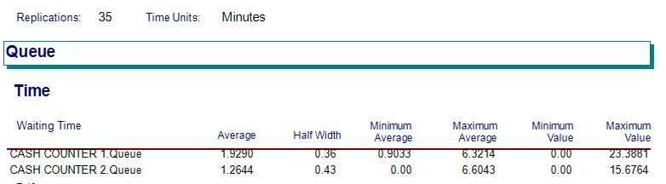
ARENA MODEL RESULT:

Slide 21
.
THANK YOU

